Slide 1
Happily together: F# and T-SQL
Dmitry Morozov, DMITRY SEVASTIANOV
AUGUST 26, 2014

Slide 2
Interesting facts from TIOBE Index
T-SQL – "Programming Language of the Year“ in 2013
The award is given to the programming language that has the highest rise in ratings in a year.
F# - as of today moved up 37 places since July 2013
Both are doing remarkably well

Slide 3

If both are so good LET’S JUST ADD them UP WHAT POSSIBLY CAN GO WRONG ?

Slide 4

The Vietnam of Computer Science

Slide 5
A less scary version

Slide 6
T-SQL DATA ACCESS OPTIONS for F# developers
 | Productivity | Types/IDE | Abstraction | Performance | Control
ADO.NET | NO | NO | NO | YES | YES
ORM - EF | - | - | - | NO | NO
Light ORM - Dapper | - | - | - | YES | YES
LINQ - SQLProvider | YES | YES | - | NO | NO

Slide 7
SqlCommandProvider Bridging the gap between F# types and T-SQL scripting

Slide 8
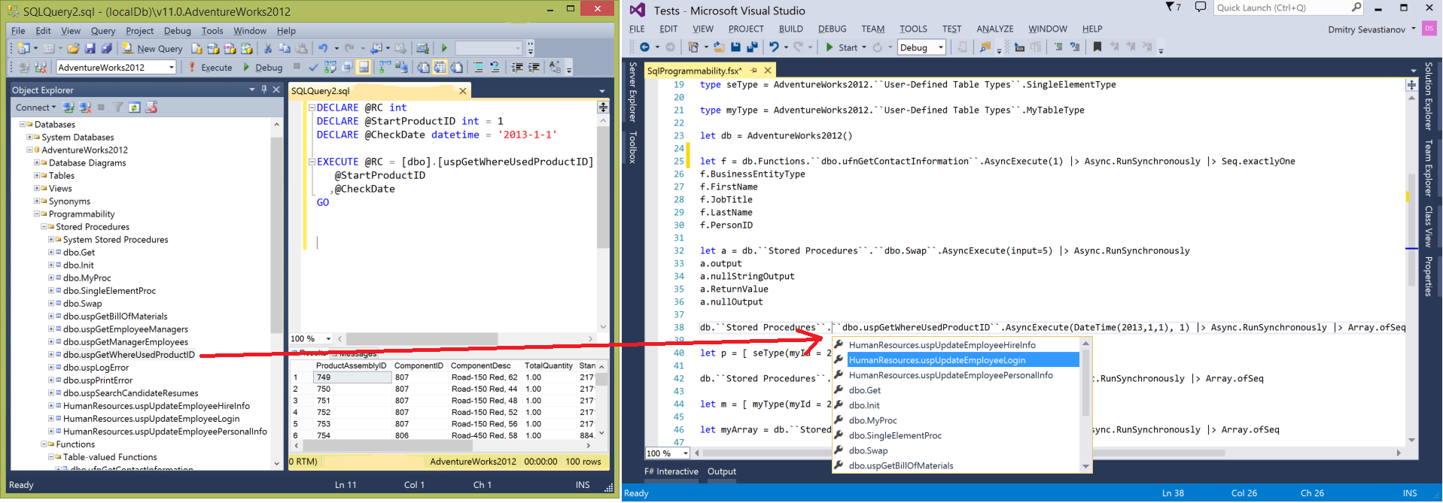
SqlProgrammabilityProvider

Slide 9
SqlProgrammabilityProvider
Brining SMSS Object explorer into Visual Studio Intellisense
Stored procedures, table-valued user-defined functions, user-defined table types
Support for Microsoft.SqlServer.Types:
SqlHierarchyId
SqlGeography
SqlGeometry

Slide 10
SqlProgrammabilityProvider
Features at glance:
Connection string retrieval similar to SqlCommandProvider
Support for default parameters in Stored Procedures
Support for output parameters and ReturnValue in Stored Procedures
Support for User-Defined Table Types – both for Stored Procedures and Table-valued UDFs

Slide 11
Bonus - SqlEnumProvider

